Slide 1
Physical & Sensorimotor
Following a brain injury

Slide 2
Definition
Physical and sensorimotor problems can include pain as well as changes in hearing and vision.

Slide 3
What to Look For..
Dizziness, headaches, difficulty hearing, light/noise sensitivity

Slide 4
What to Look For..
Difficulty reading due to vision changes

Slide 5
What to Look For..
Challenges with focus or concentration due to pain or light/noise sensitivity

Slide 6
What to Look For..
Lack of coordination

Slide 7
Accommodations for Physical & Sensorimotor
Notice what increases your symptoms by keeping a journal of daily activity

Slide 8
Power of Patients

Slide 9
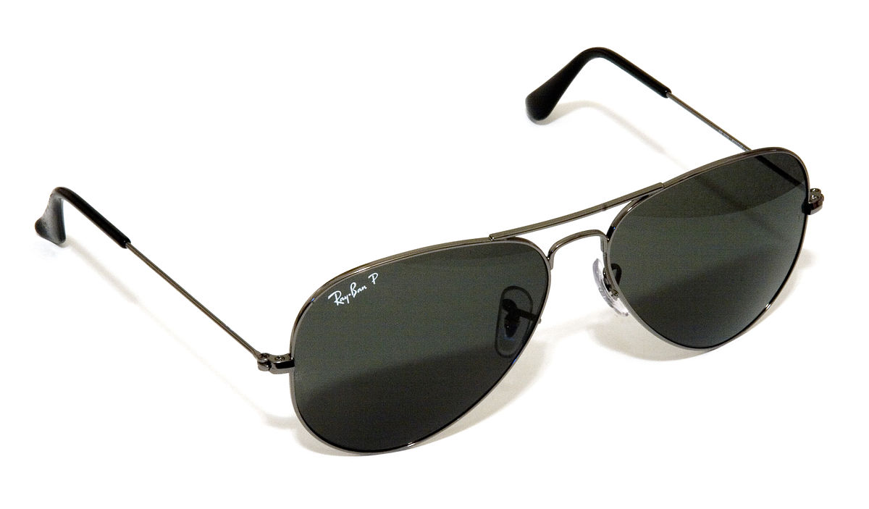
Accommodations for Physical & Sensorimotor
Avoid overhead lights, (especially fluorescent), close blinds, use lamps, wear sunglasses

Slide 10
Accommodations for Physical & Sensorimotor
Limit substances like caffeine, alcohol, and tobacco as they can make headaches, light sensitivity, and pain worse

Slide 11
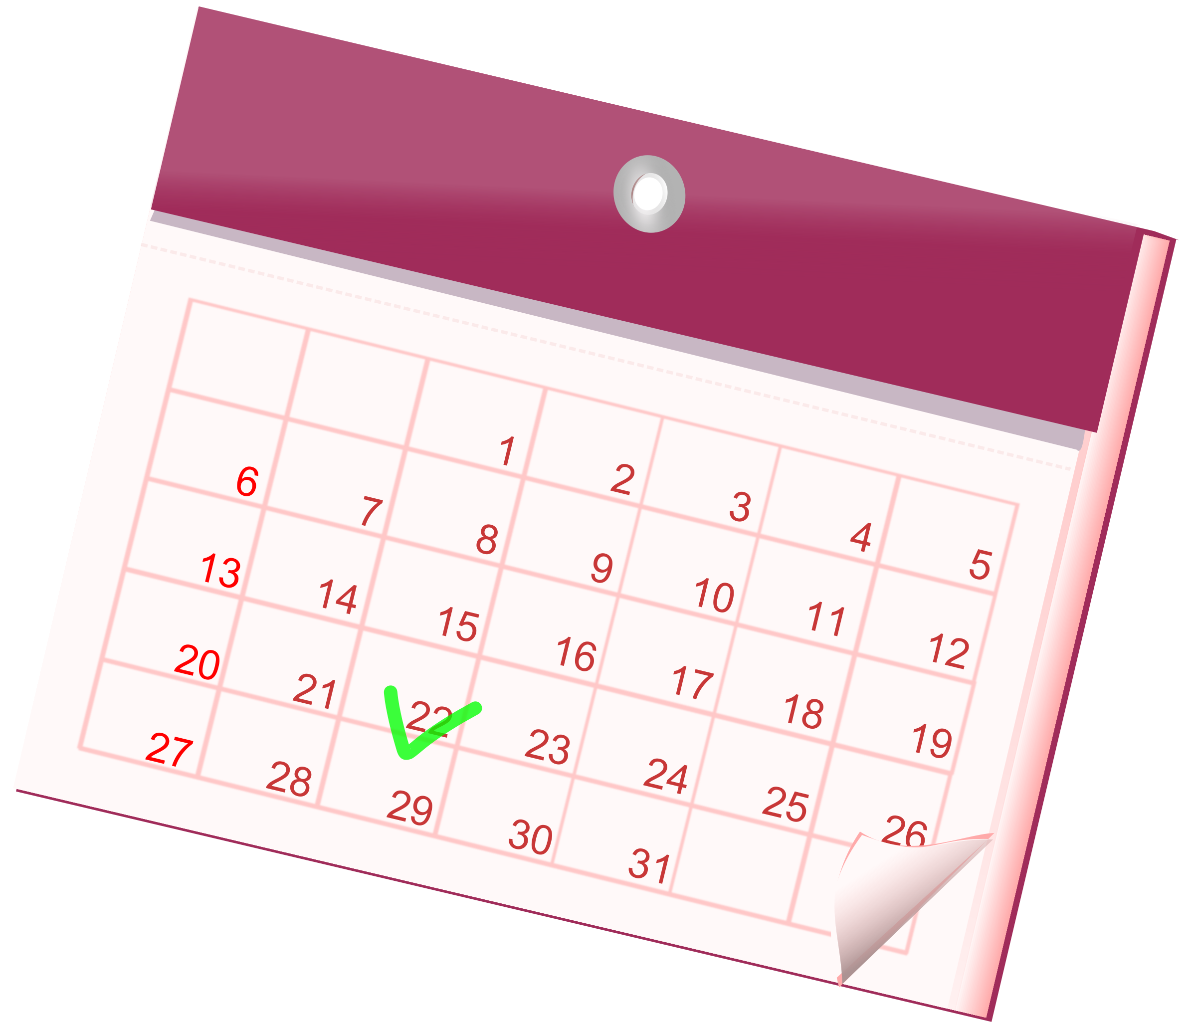
Accommodations for Physical & Sensorimotor
Keep a structured daily routine

Slide 12
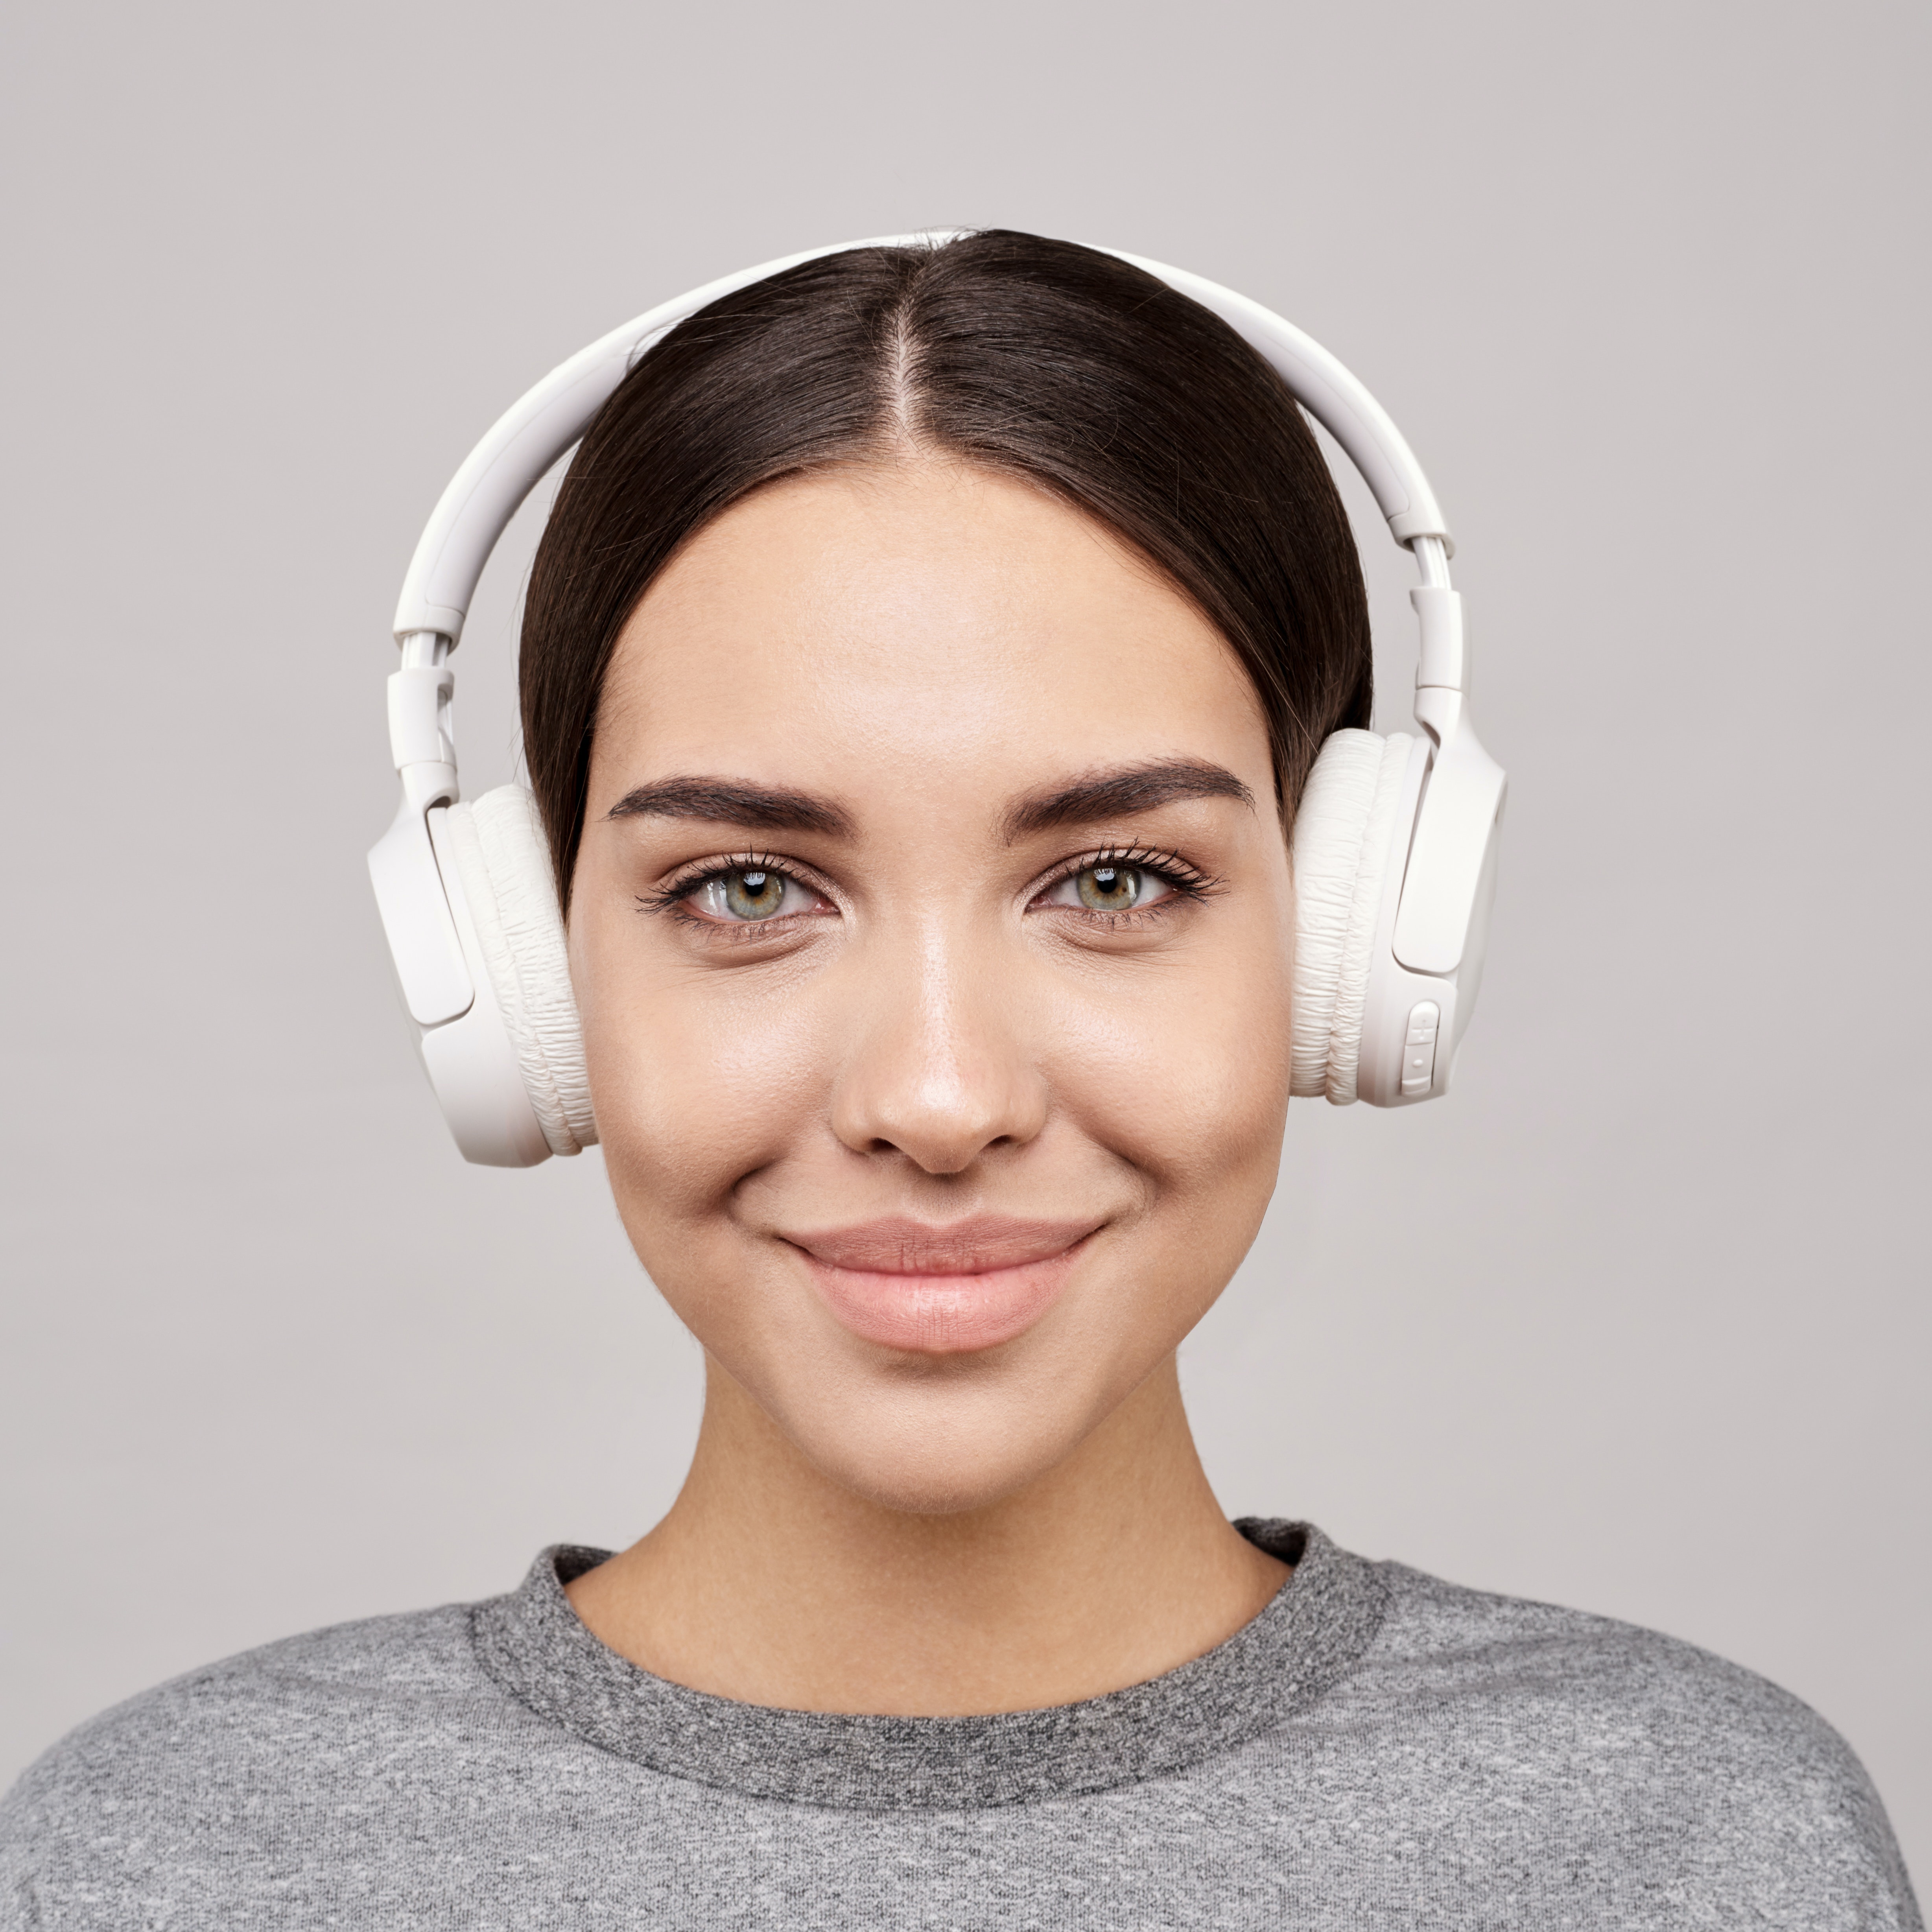
Accommodations for Physical & Sensorimotor
Use earplugs or noise canceling headphones

Slide 13
Accommodations for Physical & Sensorimotor
Schedule breaks after difficult or mentally taxing tasks

Slide 14
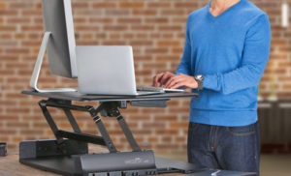
Accommodations for Physical & Sensorimotor
Try using alternative seating such as a standing desk or ball chair

Slide 15
Accommodations for Physical & Sensorimotor
Sit at the front of the room during meetings or in group settings

Slide 16
Accommodations for Physical & Sensorimotor
Advocate for yourself! Ask for:
large print options,
for breaks,
dim the lights,
or to close doors during meetings!

