Slide 1
Delayed Processing
Following a brain injury

Slide 2
Defining Delayed Processing
Delayed processing is the brain’s decreased/slowed ability to process information you hear, see, or think about.

Slide 3
Processing
Attention
Memory
Processing
Executive Function
Metacognition/
Awareness
Categorization
The time it takes a person to gather the information presented, process it, and respond.
Notes:
Processing-determing what am I doing right now? Is this something I need to remember? Do I need to categorize it? Probably the part of cognition we have the least understanding of, and how that decision making happens
We don’t understand why some people process information differently than others
We know there are glitches but not necessarily why
Speed in particular is often affected by a BI; they need more time to understand.
Give information, then give processing time…for example: “Okay, we’re leaving right now for you doctors apt” rather give them time to process “In 30 minutes we are going to your doctors appt”; leave lulls in conversation

Slide 4
What to Look For..
Hard time keeping up with the pace of conversations

Slide 5
What to Look For..
Difficulty following directions or missing steps

Slide 6
What to Look For..
Prone to distractions or "zone out"

Slide 7
What to Look For..
Often feeling tired/mentally foggy

Slide 8
What to Look For..
Viewed as unmotivated/slow moving

Slide 9
What to Look For..
Misunderstood as uncooperative, or resistant due to slow responsiveness

Slide 10
Accommodations for Delayed Processing
Ask for extra time in groups or classes

Slide 11
Accommodations for Delayed Processing
Ask for meetings to be held in places free of distractions

Slide 12
Accommodations for Delayed Processing
To help you follow directions with a lot of steps, write the steps down and do one at a time

Slide 13
Accommodations for Delayed Processing
Write down tasks step by step

Slide 14
Accommodations for Delayed Processing
Ask for clarification if there is something you do not understand

Slide 15
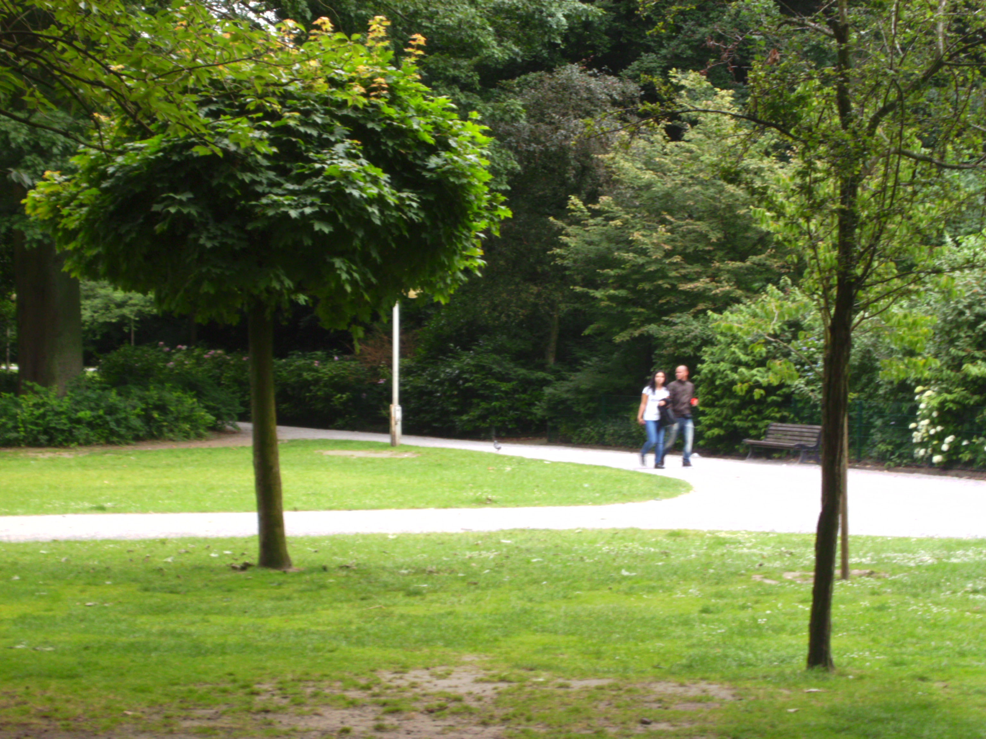
Accommodations for Delayed Processing
Physical activity supports brain function; make sure to add exercise to your day

Slide 16
Advocate for your needs!

